Slide 1
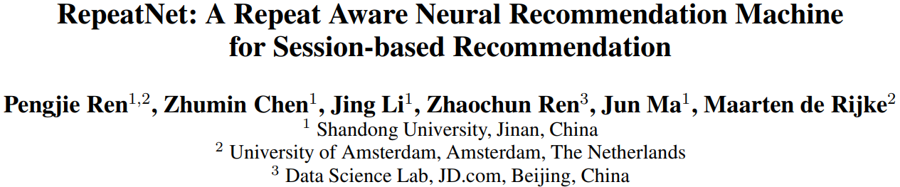

Slide 2
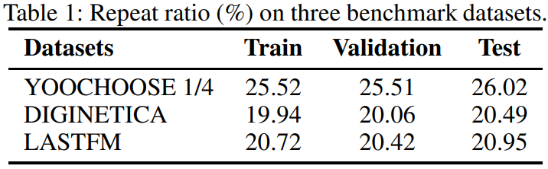
Motivation
Repeat consumption: the patterns by which a user consumes the same item repeatedly over time, in a wide variety of domains, ranging from check-ins at the same business location to re-watches of the same video and the recency of consumption is the strongest predictor of repeat consumption.
A repeat-explore mechanism for session-based recommendation to automatically learn the switch probabilities between repeat and explore modes.

Slide 3
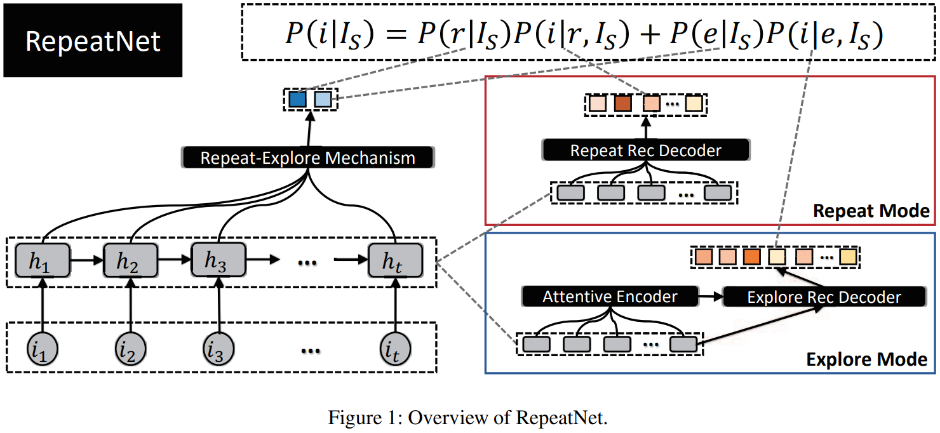
Overview of RepeatNet

Slide 4
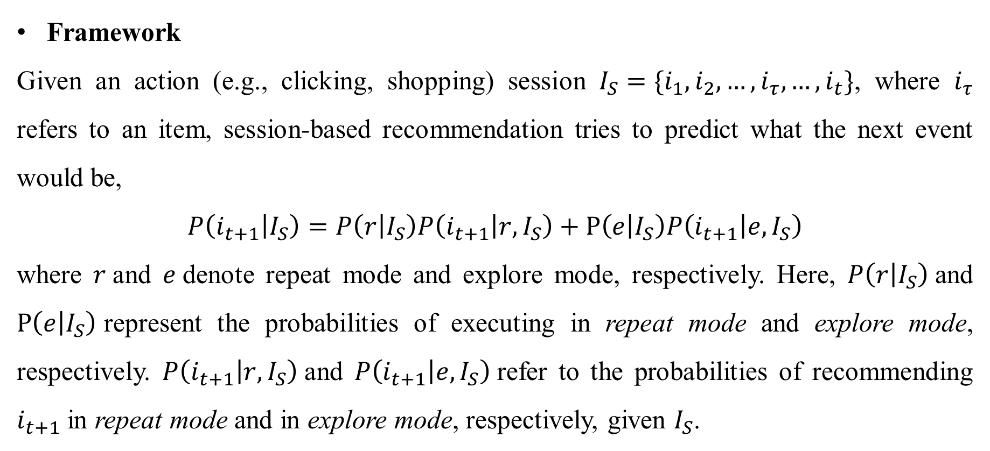
RepeatNet
Framework
Given an action (e.g., clicking, shopping) session $I_{S}=\{i_{1},i_{2},…,i_{τ},…,i_{t}\}$, where $i_{τ}$ refers to an item, session-based recommendation tries to predict what the next event would be,
$$P\left(i_{t+1} | I_{S}\right)=P\left(r | I_{S}\right)P\left(i_{t+1} | r,I_{S}\right)+P\left(e | I_{S}\right)P\left(i_{t+1} | e,I_{S}\right)$$
where $r$and $e$denote repeat mode and explore mode, respectively. Here, $P\left(r | I_{S}\right)$and $P\left(e | I_{S}\right)$represent the probabilities of executing in repeat mode and explore mode, respectively. $P\left(i_{t+1} | r,I_{S}\right)$and $P\left(i_{t+1} | e,I_{S}\right)$refer to the probabilities of recommending $i_{t+1}$in repeat mode and in explore mode, respectively, given $I_{S}$.

Slide 5
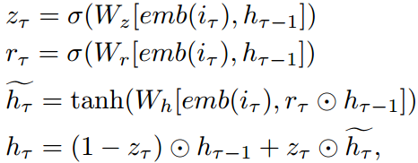
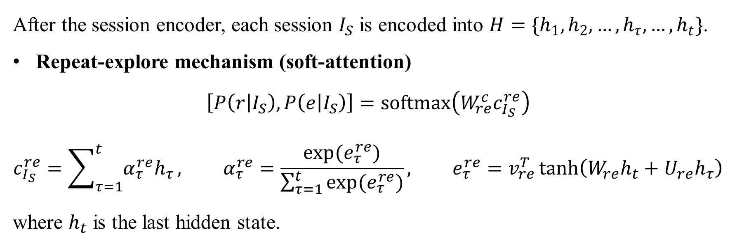
RepeatNet
Session encoder (GRU)
After the session encoder, each session $I_{S}$ is encoded into $H=\{h_{1},h_{2},…,h_{τ},…,h_{t}\}$.
Repeat-explore mechanism (soft-attention)
$$\left[P\left(r | I_{S}\right),P\left(e | I_{S}\right)\right]=softmax\left(W_{re}^{c}c_{I_{S}}^{re}\right)$$
$$c_{I_{S}}^{re}=\sum_{τ=1}^{t}{α_{τ}^{re}h_{τ}}, α_{τ}^{re}=\frac{exp⁡(e_{τ}^{re})}{\sum_{τ=1}^{t}{{exp⁡(e}_{τ}^{re})}}, e_{τ}^{re}=v_{re}^{T}\tanh\left(W_{re}h_{t}+U_{re}h_{τ}\right)$$
where $h_{t}$ is the last hidden state.

Slide 6
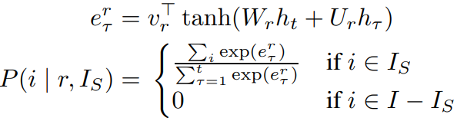
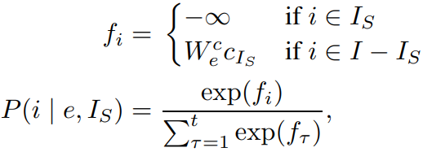
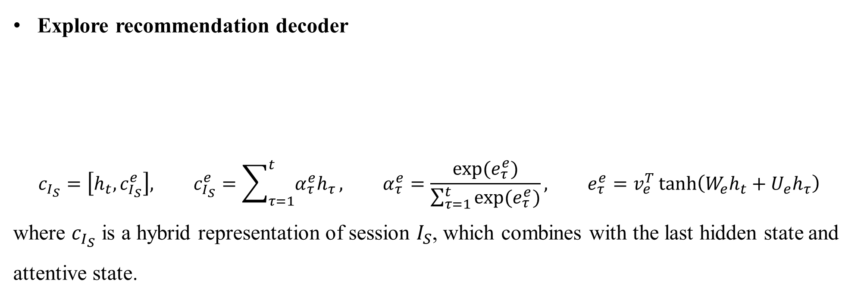
RepeatNet
Repeat recommendation decoder
Explore recommendation decoder
$$c_{I_{S}}=\left[h_{t},c_{I_{S}}^{e}\right], c_{I_{S}}^{e}=\sum_{τ=1}^{t}{α_{τ}^{e}h_{τ}}, α_{τ}^{e}=\frac{exp⁡(e_{τ}^{e})}{\sum_{τ=1}^{t}{{exp⁡(e}_{τ}^{e})}}, e_{τ}^{e}=v_{e}^{T}\tanh\left(W_{e}h_{t}+U_{e}h_{τ}\right)$$
where $c_{I_{S}}$ is a hybrid representation of session $I_{S}$, which combines with the last hidden state and attentive state.

Slide 7
RepeatNet
Repeat recommendation decoder
Explore recommendation decoder
$$c_{I_{S}}=\left[h_{t},c_{I_{S}}^{e}\right], c_{I_{S}}^{e}=\sum_{τ=1}^{t}{α_{τ}^{e}h_{τ}}, α_{τ}^{e}=\frac{exp⁡(e_{τ}^{e})}{\sum_{τ=1}^{t}{{exp⁡(e}_{τ}^{e})}}, e_{τ}^{e}=v_{e}^{T}\tanh\left(W_{e}h_{t}+U_{e}h_{τ}\right)$$
where $c_{I_{S}}$ is a hybrid representation of session $I_{S}$, which combines with the last hidden state and attentive state.

Slide 8
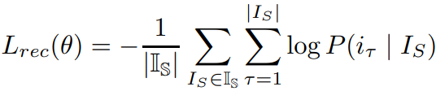

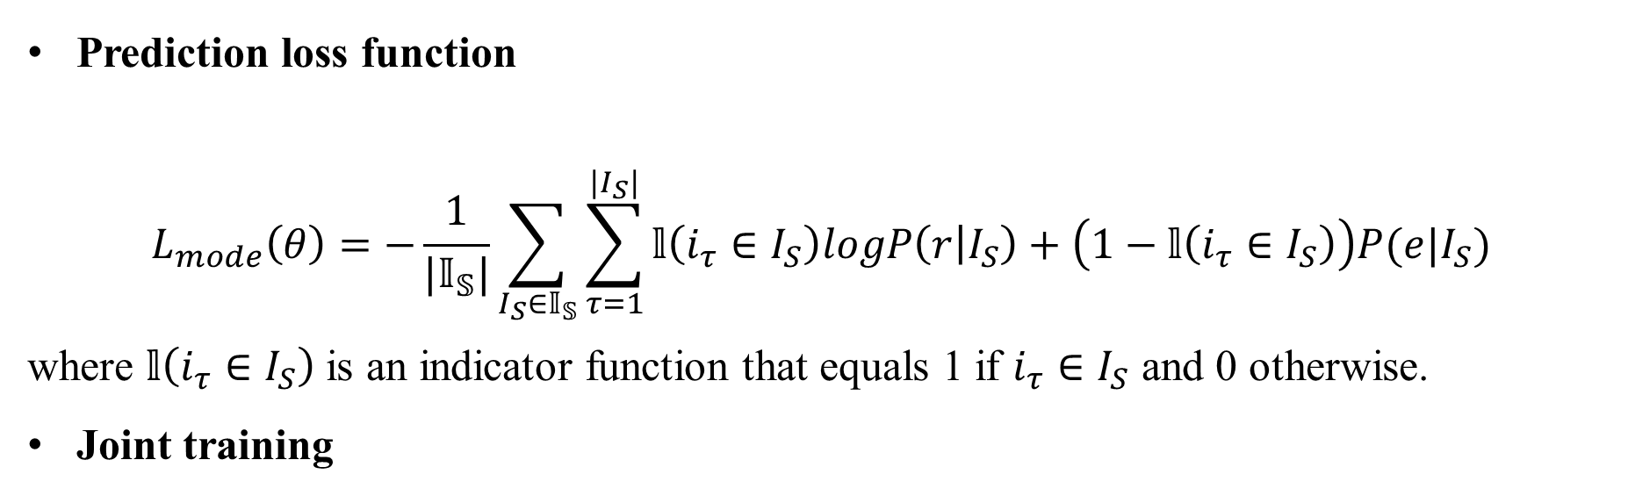
Objective Function
Prediction loss function
Prediction loss function
$$L_{mode}\left(θ\right)=−\frac{1}{|𝕀_{𝕊}|}\sum_{I_{S}∈𝕀_{𝕊}}{\sum_{τ=1}^{|I_{S}|}{𝕝\left(i_{τ}∈I_{S}\right)logP\left(r | I_{S}\right)+\left(1−𝕝\left(i_{τ}∈I_{S}\right)\right)P(e|I_{S})}}$$
where $𝕝\left(i_{τ}∈I_{S}\right)$ is an indicator function that equals 1 if $i_{τ}∈I_{S}$ and 0 otherwise.
Joint training

Slide 9
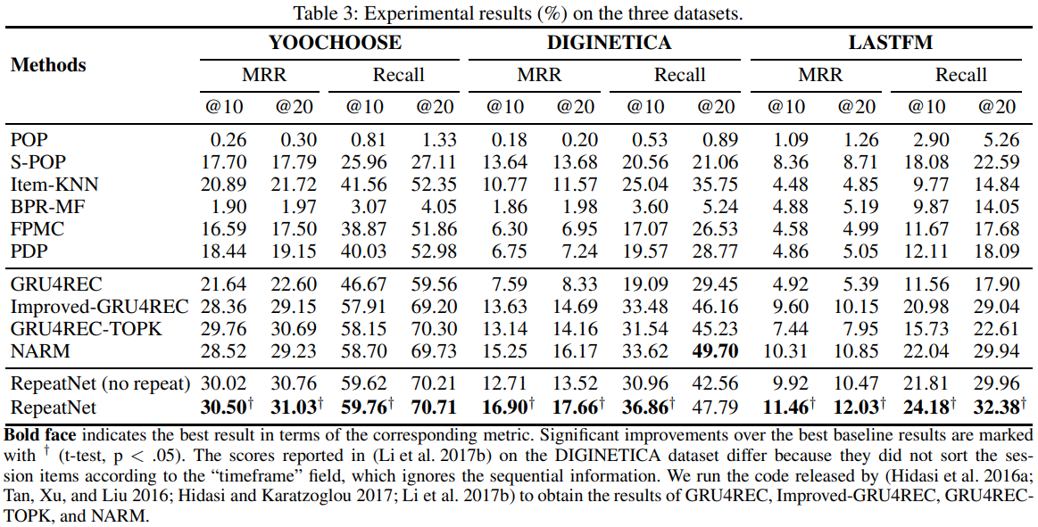
Experiments

Slide 10
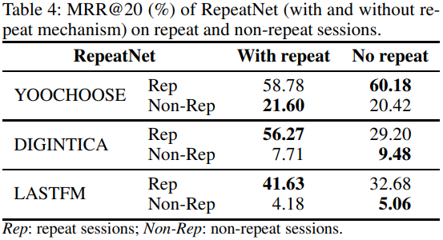
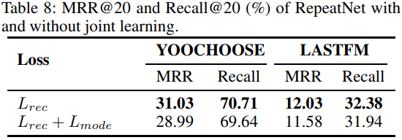
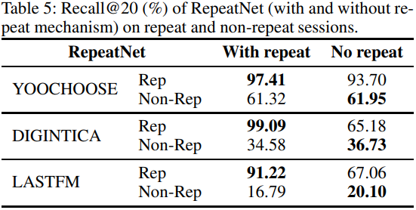
Experiments

